Slide 1
Anura3D Training Course – UC Berkeley 6 September, 2019
Overview of Anura3D

Slide 2
Outline
1. Anura3D research community
2. Brief history of developments
3. Software implementation features
4. Available tools
5. Anura3D release 2019.2 - Ilex
6. Future developments

Slide 3





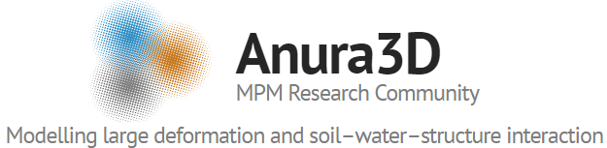






Anura3D research community
9 University + 2 research centers

Slide 4
























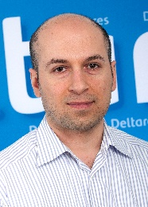


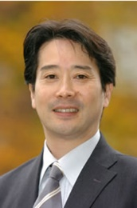

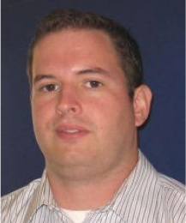





Anura3D research community

Slide 5







Brief history
2015
2008
3D, dynamic explicit
Contact algorithm
2P-SP formulation
2014: 1st MoU
3P-SP formulation
2016
New constitutive models
2P-DP formulation
Implicit quasi-static
Performance enhancement
2D plane strain/axisym
2017
2019

Slide 6

Anura3D research community
Github website: Anura3D.com
Twitter account: Anura3D
YouTube account: Anura3D

Slide 7
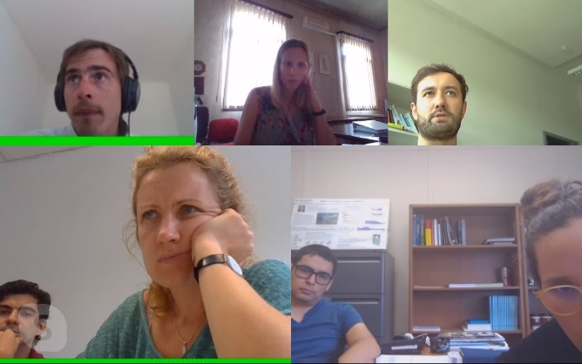

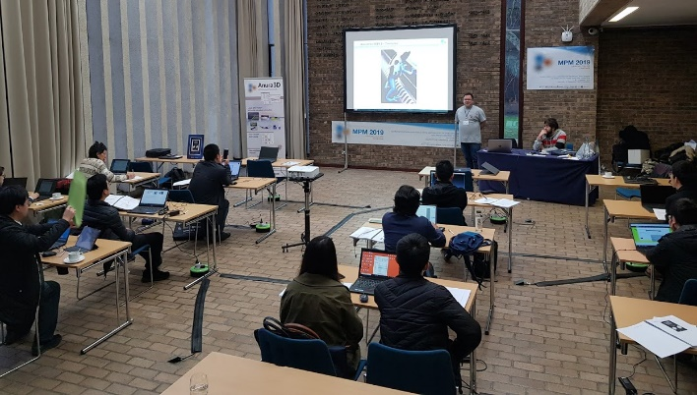
Anura3D research community
Zoom meeting
Regular activities
Weekly zoom meeting
Management
workshops / conferences
training
Joint coordination and development
research & projects
software functionality
Software releases
Board meeting, Padua, 2015
Training course, Cambridge 2019

Slide 8
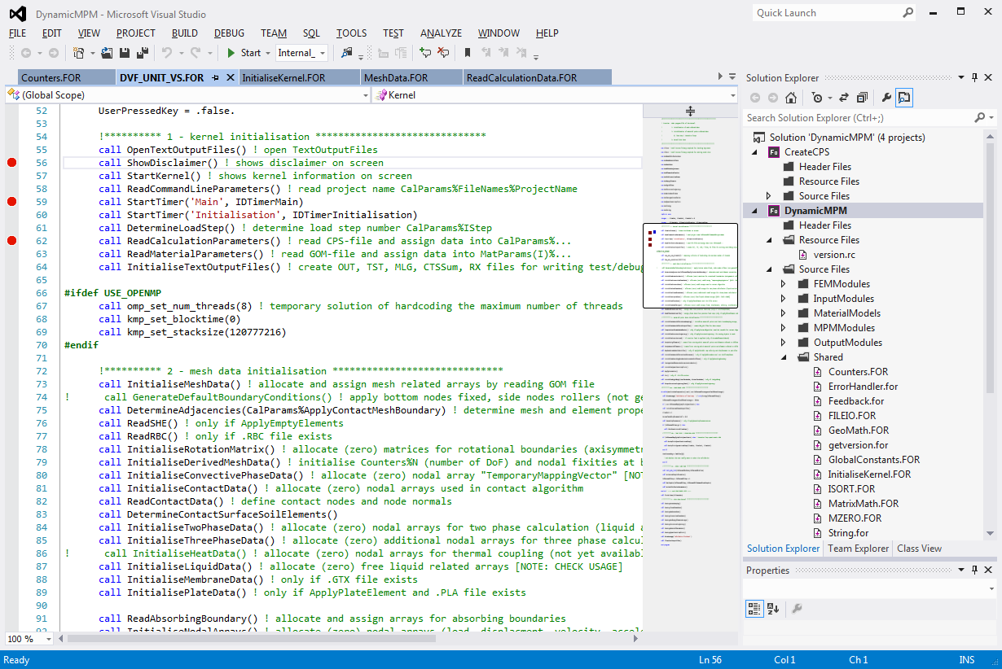
R&D code
Fortran

Slide 9
Anura3D software features
Dimensions:
3D (cartesian, cylindrical),
2D – plane strain,
2D – axisymmetric
Integration schemes:
explicit,
implicit
Constitutive models:
LE, MC, MCSS, Modified Cam-Clay, Nor-Sand, Hoek-brown, Hypoplasticity…
user defined model
Computational methods:
MPM-MP,
MPM-MIXED,
UL-FEM,
FEM
Multiphase formulations:
1-phase,
2-phase: Single point, Double point, single point with suction, erosion
3-phase: single point
Other features:
contact algorithm,
moving mesh,
Excavation,
Rigid body,
Prescribed velocity…

Slide 10
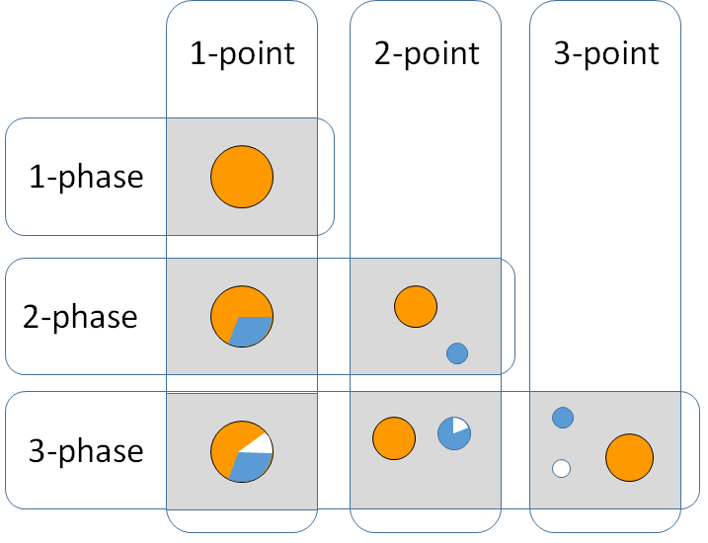
Multiphase formulations

Slide 11


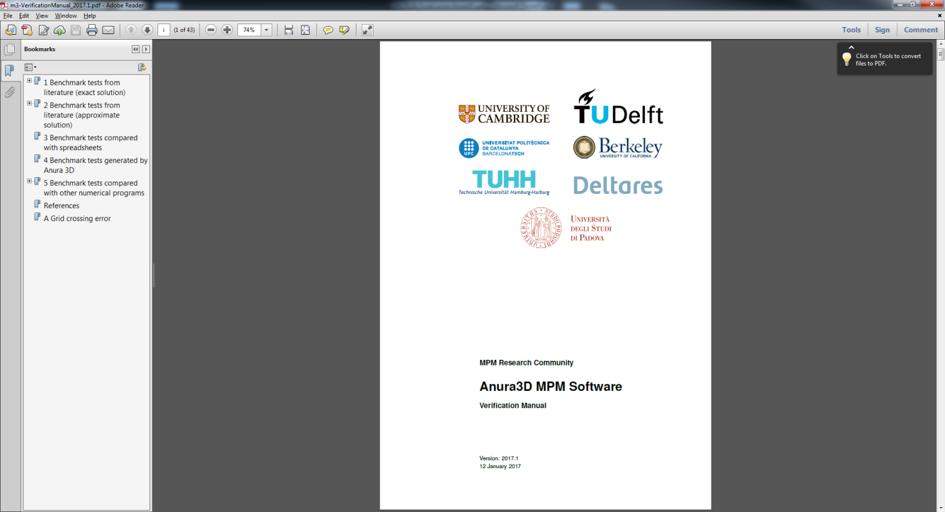
Manuals
Tutorial Scientific Verification

Slide 12

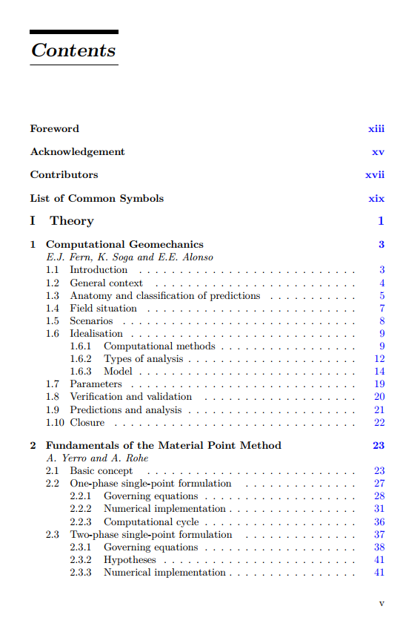
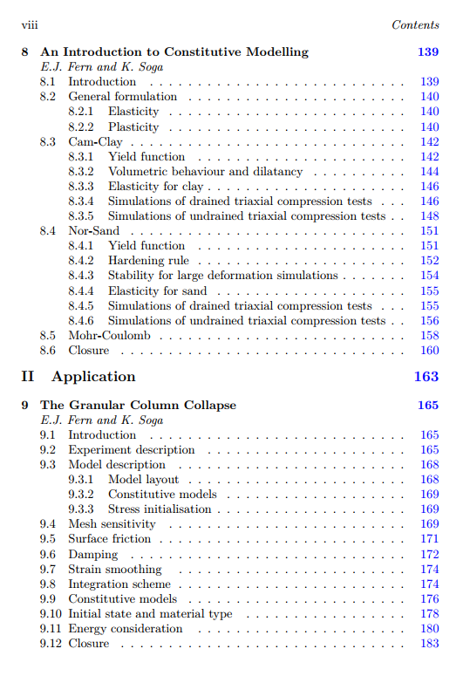
Book

Slide 13
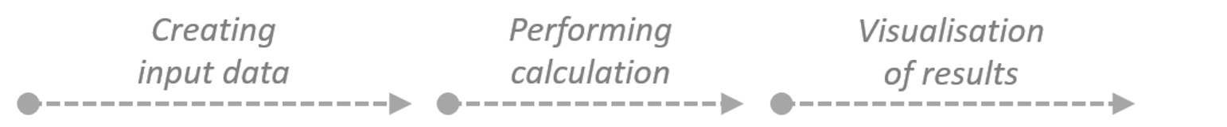


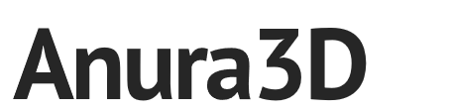

Performing a numerical simulation with Anura3D
Model
(pre-processing)
Simulation
Analysis
(post-processing)
Text files (CPS, GOM)
Fortran
Vtk files

Slide 14
Anura3D Training Course – UC Berkeley 6 September, 2024
Basis of Anura3D – For users and developers

Slide 15


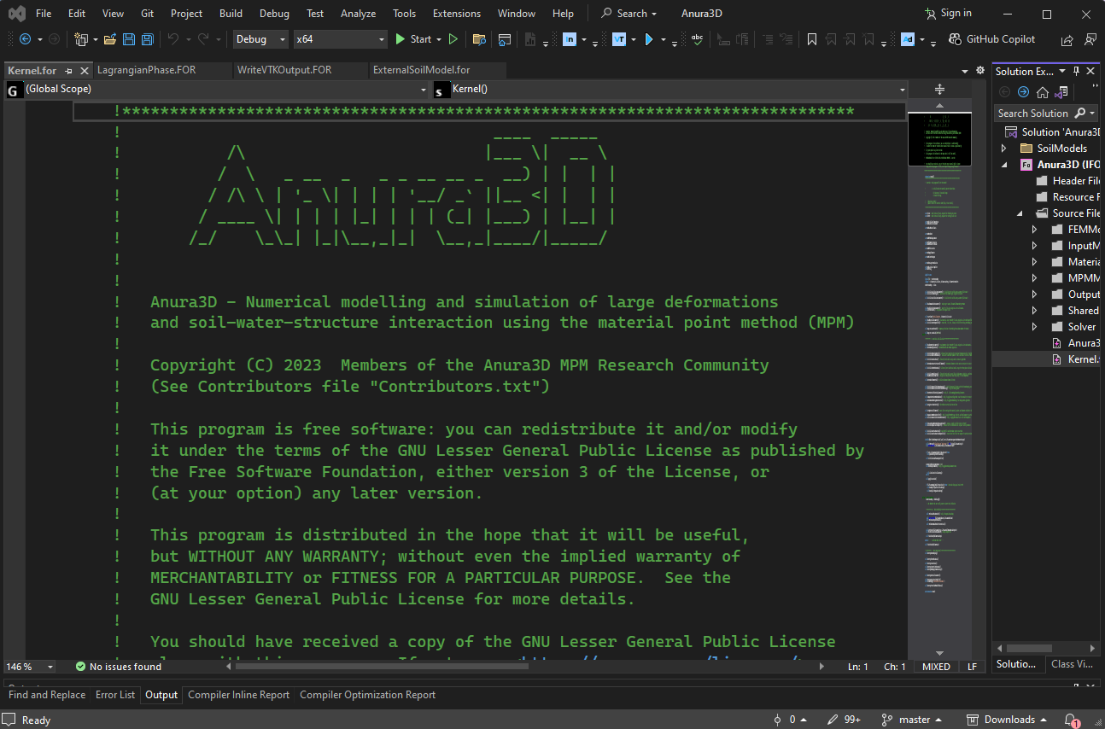
Installing Anura3D – two main components
We use the following packages to install Fortran and modify the code:
OneAPI: Fotran package from Intel which enables use of the language.
MS Visual Studio Community: IDE used to compile and modify the code.

Slide 16
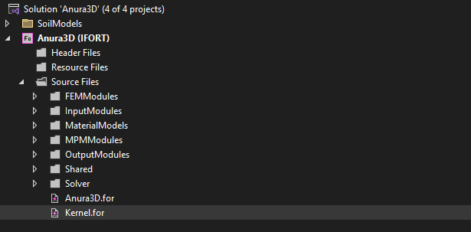
Computational cycle of the MPM – single phase
Start of the time step:
Map data (mass, loads, momentum) from particles to grid nodes.
Middle of the step (Lagrangain) – grid is moved, dragging particles along via ‘FEM-type’ mapping of momentum:
Solve discretized momentum equations on predefined background grid.
Use standard mapping to map data to particles
End of the time step:
Reset grid if you want particles to move through the grid in an Eulerian manner
In Anura3D, the solution consists of many modules which are organized as you can see in the solution explored in MS visual studio.

Slide 17
Computational cycle of the MPM – Time increments
There are multiple variables used in A3D to keep track of time increments. Some are associated with a load step and some with time step. There are multiple time steps in a load step.
CalParams%TimeStep → integer used to track the number of time steps in a load step.
CalParams%TimeIncrement → real time increment calculated based on the material type and is updated as the material parameters are updated.
CalParams%TotalRealTime → real time in a load step. This resets at the beginning of a load step.
CalParams%OverallRealTime → real time overall considering the entire simulation time.
Overall real time
Load Step 1
Load Step 2
Load Step 3
Total real time
Total real time
…
…
1
2
3
1
2
3
Time
Time steps
Time steps

Slide 18
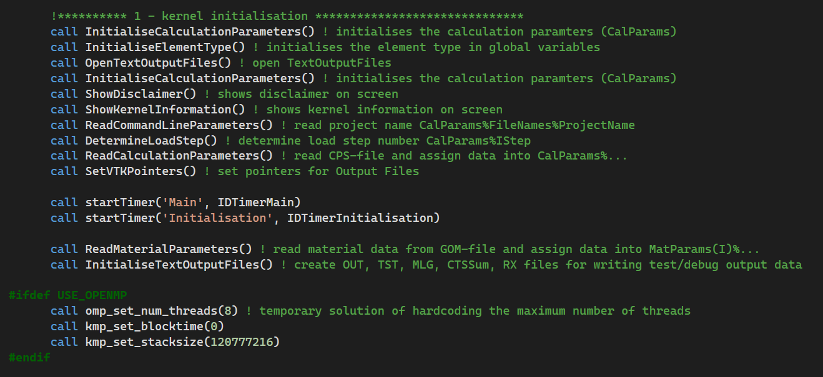
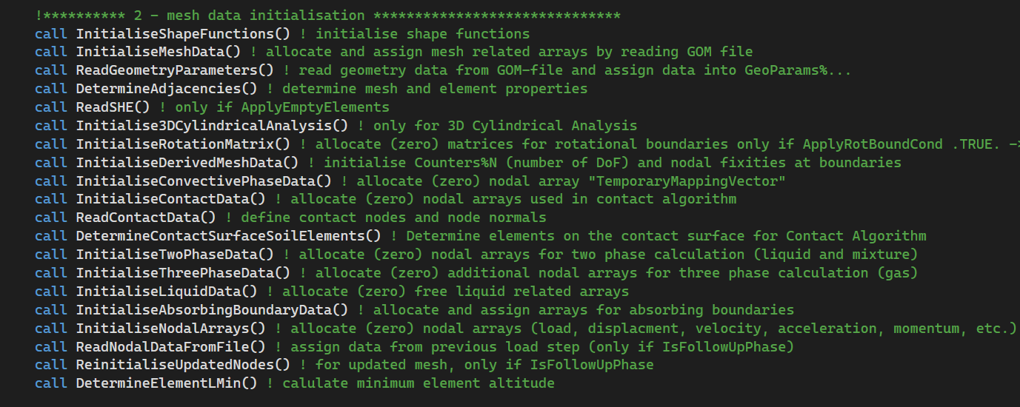
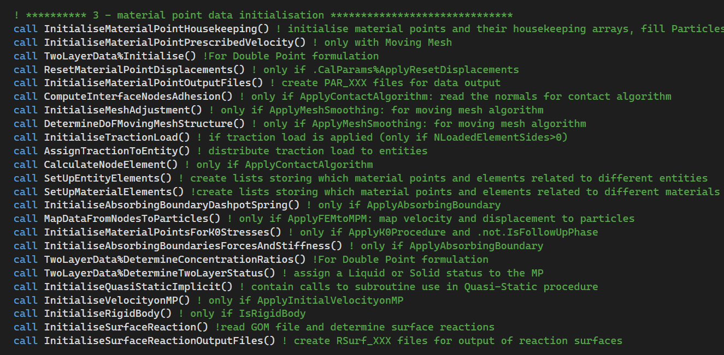
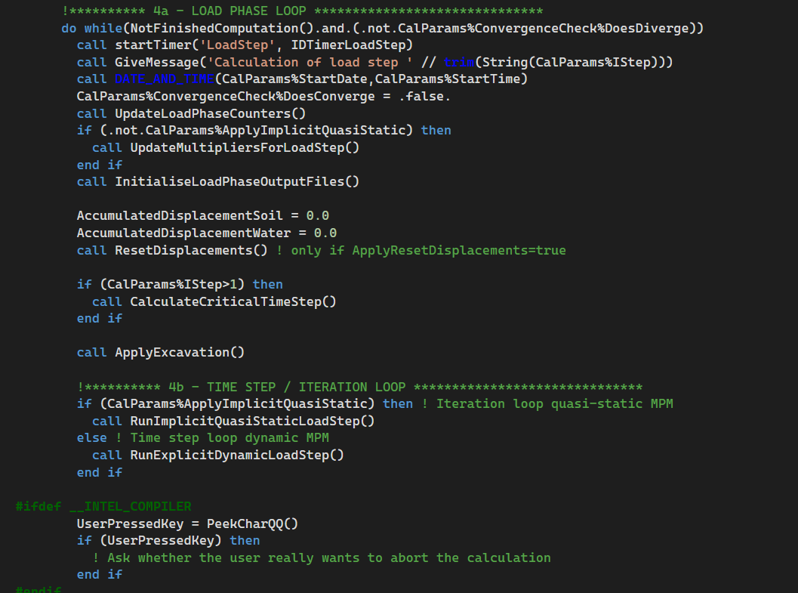
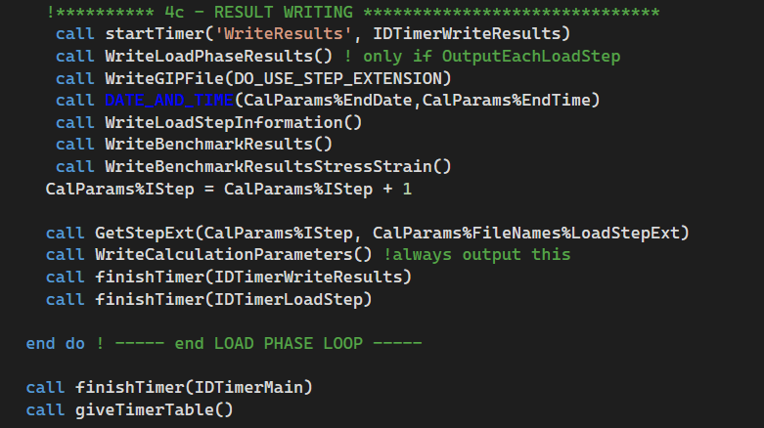
Computational cycle of the MPM – single phase
In A3D Fortran code, the kernel calls all the subroutines.

Slide 19
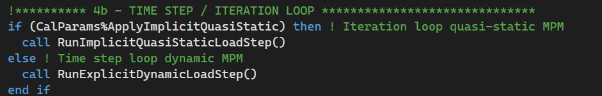
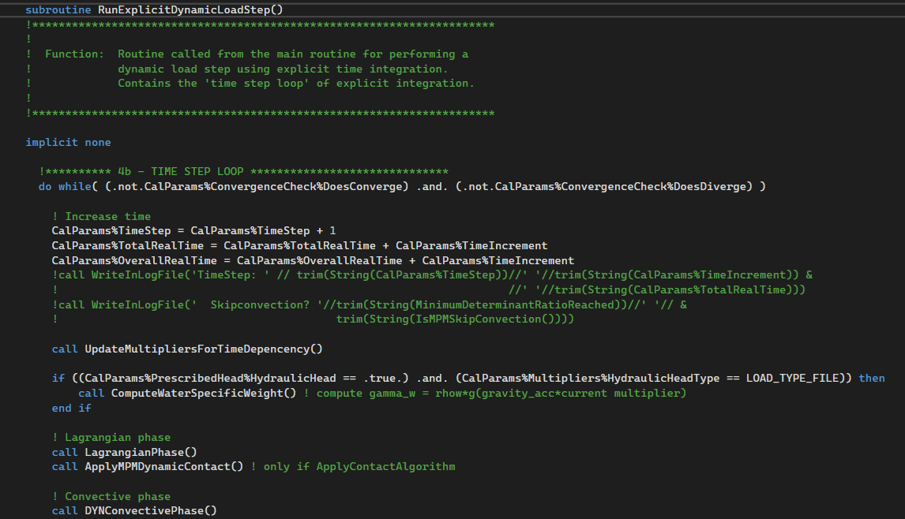
Computational cycle of the MPM – single phase
The main subroutines that perform in the calculation are as follows:
Starting from Kernel.FOR
Two key subroutines:
Lagrangian Phase, which solves for the nodal acceleration.
Convective Phase, which performs the time integration to obtain nodal velocity field, MP strains and stresses. Also, we update the material point locations.

Slide 20
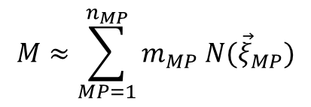
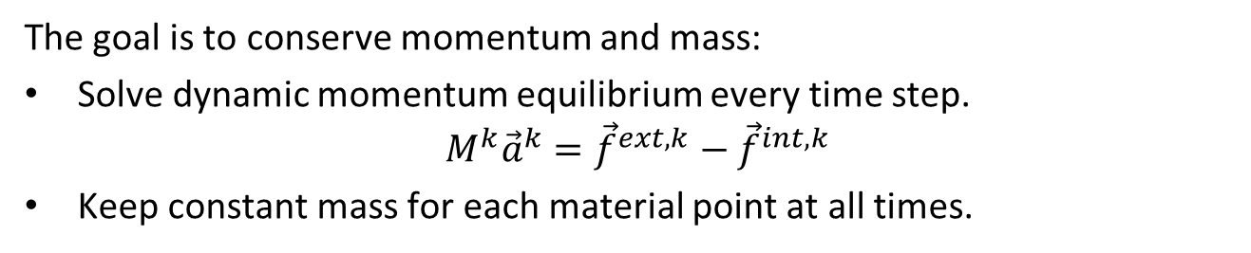
Computational cycle of the MPM – single phase
The goal is to conserve momentum and mass:
Solve dynamic momentum equilibrium every time step.
$$M^{k}{\vec{a}}^{k}={\vec{f}}^{ext,k}−{\vec{f}}^{int,k}$$
Keep constant mass for each material point at all times.
nodal forces, nodal velocities
2) Dynamic Equilibrium Liquid
3) Dynamic Equilibrium Mixture
5) Update nodal velocities
1) Nodal mass matrices
$$M≈\sum_{MP=1}^{n_{MP}}{m_{MP} N({\vec{ξ}}_{MP})}$$
Linear basis function calculated in the local domain
Mass of each material point
which is proportional to the gauss point weight in the code

Slide 21
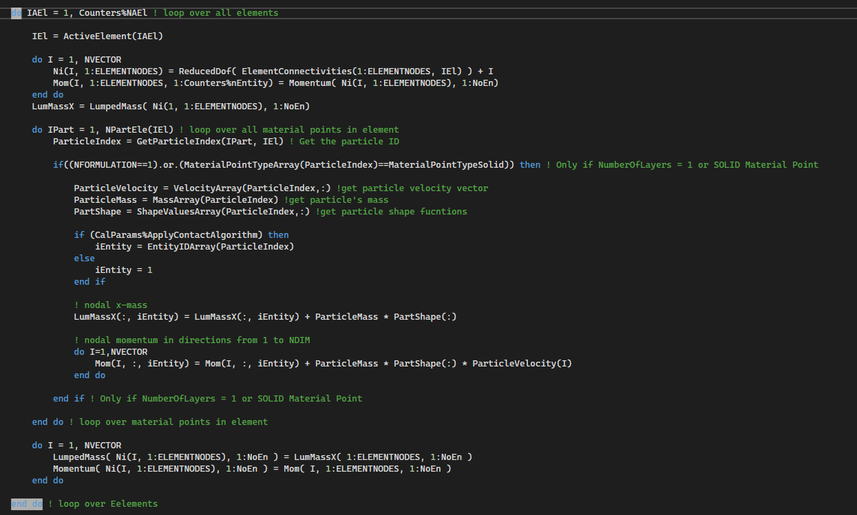
Computational cycle of the MPM – single phase
1) Nodal mass matrices → global variable name LumpedMassDry

Slide 22
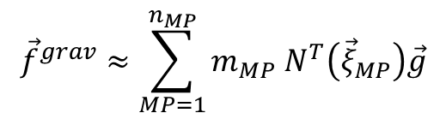
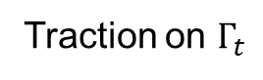
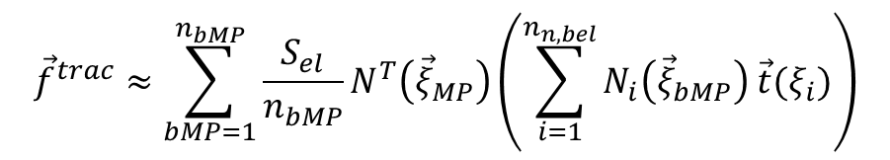
Computational cycle of the MPM – single phase
2) External force → variable name ExtLoad and GravityLoad
Two types of external forces:
Traction load
Gravity load
$${\vec{f}}^{trac}≈\sum_{bMP=1}^{n_{bMP}}{\frac{S_{el}}{n_{bMP}}N^{T}\left({\vec{ξ}}_{MP}\right)\left(\sum_{i=1}^{n_{n,bel}}{N_{i}\left({\vec{ξ}}_{bMP}\right) \vec{t}(ξ_{i})}\right)}$$
Traction on $Γ_{t}$
Gravity field
$${\vec{f}}^{grav}≈\sum_{MP=1}^{n_{MP}}{m_{MP} N^{T}\left({\vec{ξ}}_{MP}\right)\vec{g}}$$

Slide 23
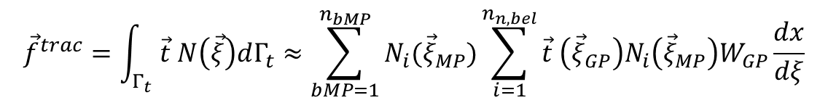
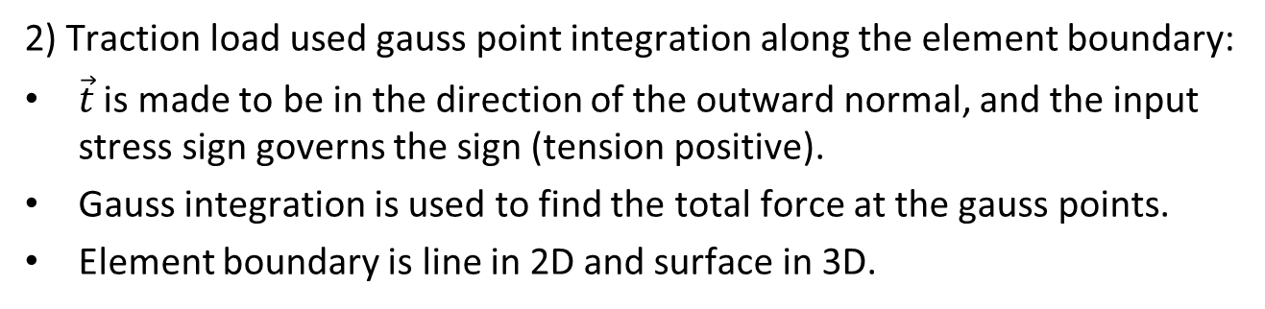
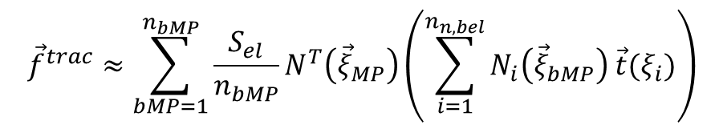
Computational cycle of the MPM – single phase
2) Traction load used gauss point integration along the element boundary:
$\vec{t}$ is made to be in the direction of the outward normal, and the input stress sign governs the sign (tension positive).
Gauss integration is used to find the total force at the gauss points.
Element boundary is line in 2D and surface in 3D.
$${\vec{f}}^{trac}=\int_{Γ_{t}}{\vec{t} N\left(\vec{ξ}\right)dΓ_{t}}≈\sum_{bMP=1}^{n_{bMP}}{N_{i}({\vec{ξ}}_{MP})\sum_{i=1}^{n_{n,bel}}{\vec{t} \left({\vec{ξ}}_{GP}\right)N_{i}\left({\vec{ξ}}_{MP}\right)W_{GP}\frac{dx}{dξ}}}$$
Element boundary
Element length approximation
$${\vec{f}}^{trac}≈\sum_{bMP=1}^{n_{bMP}}{\frac{S_{el}}{n_{bMP}}N^{T}\left({\vec{ξ}}_{MP}\right)\left(\sum_{i=1}^{n_{n,bel}}{N_{i}\left({\vec{ξ}}_{bMP}\right) \vec{t}(ξ_{i})}\right)}$$
This calculation is done in subroutines Load2D and Load3D in BuildLoad.FOR based on the selected dimensions.

Slide 24
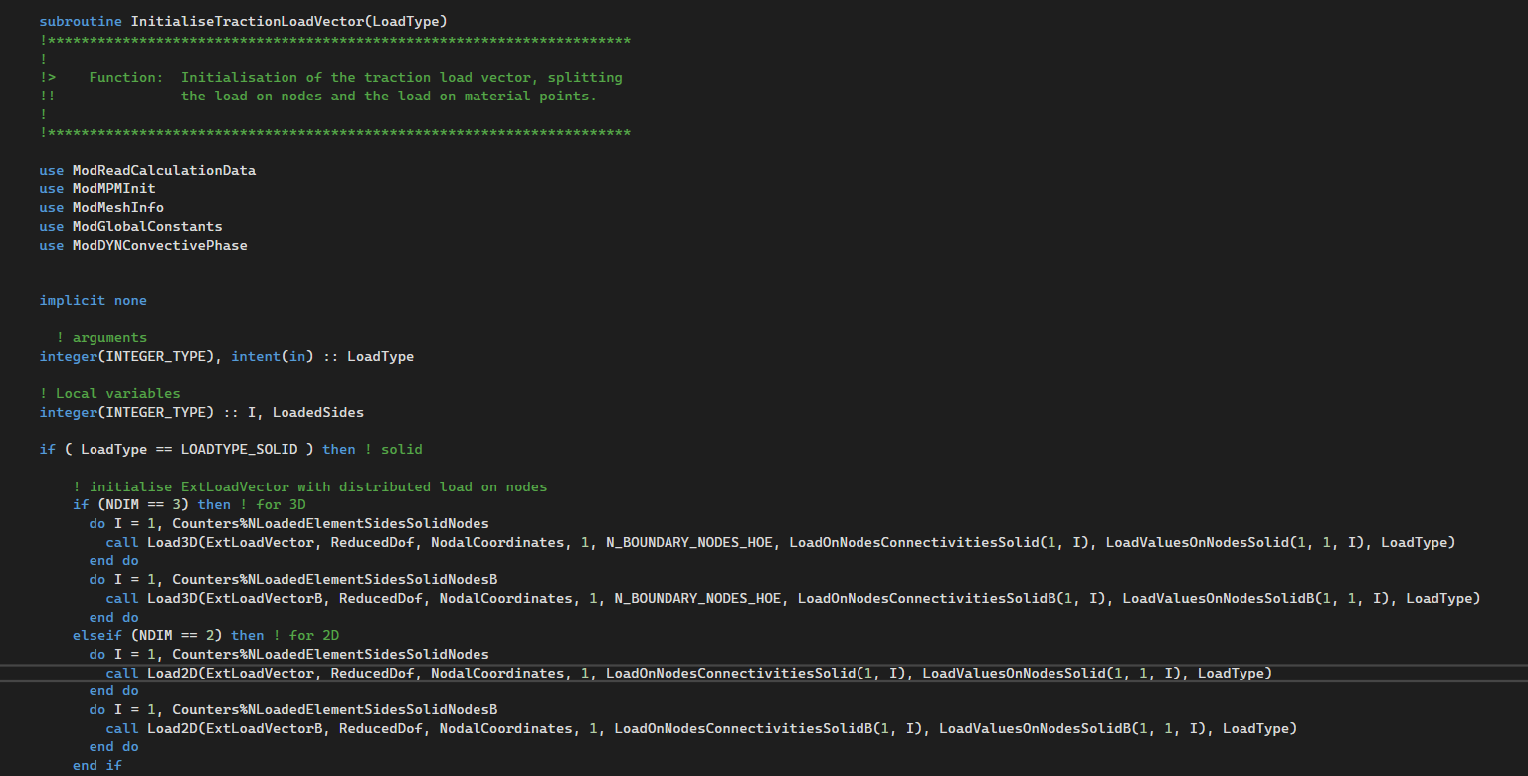
Computational cycle of the MPM – single phase
2) Traction load

Slide 25
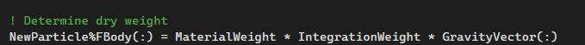
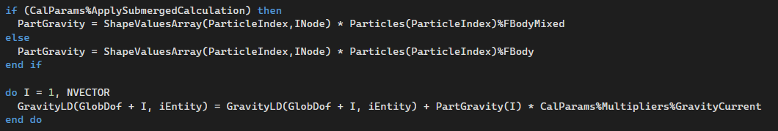
Computational cycle of the MPM – single phase
2) Gravity load is a body force calculated based on the mass of the material point:
Assembling the gravity force vector:
default [0, 9.81, 0] m/s²
MP Density
MP Volume

Slide 26
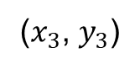
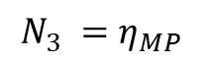
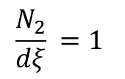
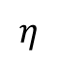
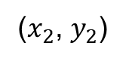
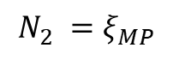
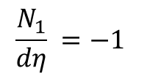

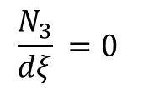
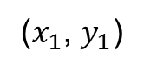
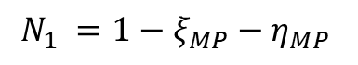
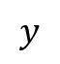
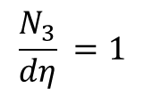
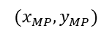
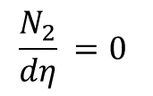
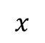
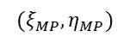

Computational cycle of the MPM – single phase
In A3D (opensource version), we use linear triangular elements in 2D and linear tetrahedral elements in 3D. Let’s look at 2D triangle shape functions:
Parent domain
Physical domain
$$η$$
3
($x_{3}$, $y_{3}$)
3
(0,1)
$${(ξ}_{MP},η_{MP})$$
$$y$$
$${(x}_{MP},y_{MP})$$
1
2
$$ξ$$
1
2
$$x$$
(0,0)
(1,0)
($x_{1}$, $y_{1}$)
($x_{2}$, $y_{2}$)
Anticlockwise nodal numbering → Element Connectivity input matrix from GOM file
$$N_{1} =1−ξ_{MP}−η_{MP}$$
$$N_{2} =ξ_{MP}$$
$$N_{3} =η_{MP}$$
$$\frac{N_{1}}{dξ} =−1$$
$$\frac{N_{1}}{dη} =−1$$
$$\frac{N_{2}}{dξ} =1$$
$$\frac{N_{2}}{dη} =0$$
$$\frac{N_{3}}{dξ} =0$$
$$\frac{N_{3}}{dη} =1$$

Slide 27

Computational cycle of the MPM – single phase

Slide 28


Computational cycle of the MPM – single phase
3) Internal force is calculated as the gradient of the material point stress field on the background grid. The gradient is calculated in the parent domain, but we need to calculate a Jacobian matrix to find the gradient in the physical domain.
MP Volume
MP Volume
$${\vec{f}}^{int}≈\sum_{MP=1}^{n_{MP}}{\frac{dN}{dξ}\left({\vec{ξ}}_{MP}\right){W_{MP}\left|\frac{d\vec{ξ}}{d\vec{x}}\right|σ}_{MP}}=\sum_{MP=1}^{n_{MP}}{\frac{dN}{d\vec{ξ}}\left({\vec{ξ}}_{MP}\right)σ_{MP}W_{MP}{\left(\left|\frac{d\vec{x}}{d\vec{ξ}}\right|\right)}^{−1}}$$
$$\frac{d\vec{x}}{d\vec{ξ}}=\sum_{i=1}^{n_{n,el}}{\sum_{j=1}^{n_{Dim}}{Co_{ij}⋅\frac{dN_{j}}{d\vec{ξ}}}}$$
Nodal Coordinates
Derivative of the shape functions
in parent domain

Slide 29

Computational cycle of the MPM – single phase
3) Internal force calculation in MPMDYNBTSig subroutine in MPMDYNBTSig.FOR

Slide 30


Computational cycle of the MPM – single phase
We calculate the nodal rate of momentum in the Lagrangian Phase: $${\vec{f}}^{k}={\vec{f}}^{grav}+{\vec{f}}^{trac}−{\vec{f}}^{int}$$
We then divide by the lumped mass to obtain the nodal acceleration:
We call this in LagrangianPhase.FOR
4) We calculate the acceleration and store it in a variable called AccelerationSoil:

Slide 31



Computational cycle of the MPM – single phase
5) In the A3D, we use a momentum formulation because acceleration can be very large when the node has a small mass. The time integration scheme calculates the velocity at the material points.
6) We then calculate nodal momentum before we finally calculate the velocity field.
$${\vec{v}}_{MP}^{k+1}={\vec{v}}_{MP}^{k}+Δt \sum_{i=1}^{n_{n,el}}{N_{i}\left({\vec{ξ}}_{MP}^{k}\right) {\vec{a}}_{i}^{k}}$$
$${\vec{P}}_{i}^{k+1}=\sum_{el=1}^{n_{el,i}}{\sum_{MP=1}^{n_{MP}}{m_{MP}N_{i}\left({\vec{ξ}}_{MP}^{k}\right){\vec{ v}}_{MP}^{k+1}}}$$
$${\vec{v}}_{i}^{k+1}=\frac{{\vec{P}}_{i}^{k+1}}{M_{i}^{k}}$$

Slide 32


Computational cycle of the MPM – single phase
We update particle velocity in DYNConvectivePhase() subroutine.
We calculate nodal velocity in DYNConvectivePhase() subroutine.

Slide 33


Computational cycle of the MPM – single phase
7) We calculate the nodal incremental displacement as follows:
This is calculated in DYNConvectivePhase() subroutine.
$$Δ{\vec{u}}_{i}^{k+1}=Δt {\vec{v}}_{i}^{k+1}$$

Slide 34






Computational cycle of the MPM – single phase
We call this subroutine in DYNConvectivePhase() subroutine.
8) Using the incremental displacement field of an element, we can calculate strain of each material point:
For example, in 2D:
$${Δ\vec{ε}}_{MP,xx}^{k+1}=\frac{dN}{dx}{Δu}_{x}$$
$${Δ\vec{ε}}_{MP}^{k}=B\left({\vec{ξ}}_{MP}^{k}\right) Δ{\vec{u}}_{i}^{k+1}$$
$${Δ\vec{ε}}_{MP,yy}^{k+1}=\frac{dN}{dy}{Δu}_{y}$$
$${Δ\vec{ε}}_{MP,xy}^{k+1}=\frac{dN}{dx}{Δu}_{y}+\frac{dN}{dy}{Δu}_{x}$$
Calculate derivative of shape functions
Calculate strain increment (Eps)

Slide 35


Computational cycle of the MPM – single phase
9) After we calculate the strain increment, we need to use a constitutive model (for each phase) to calculate the stress. In the convective phase:
This takes to a module called MPMDYNStresses.FOR. The consitutitve relationship is called in the following subroutine:
We initialize state variables for each material point:
Finally, we calculate the stress here:

Slide 36
Computational cycle of the MPM – single phase
In the ESM subroutine, we call the UMAT following the ABAQUS standard:
Many users use Anura3D with an external soil model. The following few slides will attempt to summarize instructions to include your UMAT in the A3D code. The steps can be summarized as follows:

Slide 37


Computational cycle of the MPM – single phase

Slide 38


Computational cycle of the MPM – single phase

Slide 39


Computational cycle of the MPM – single phase

Slide 40


Computational cycle of the MPM – single phase

Slide 41


Computational cycle of the MPM – single phase
In MP integration, we calculate the strain and stress of each material point. Naturally, in the case of linear triangle elements, the strain and stress is constant within an element. This is because the shape function derivatives are constant. The MP integration is known to cause oscillation and cell-crossing error.
GP integration is often used to mitigate this error. However, in GP integration, we calculate the strain at a single point gauss point in an element and the stress at that point. We then overwrite the stress and the state variables for all the material points in the element.
$Δε_{MP}$ and state variables
are calculated at the gauss point. We force the stress and state variables to be the same in the entire element
i
i
$Δε_{MP}$ and state variables
are calculated uniquely for each material point

Slide 42


Computational cycle of the MPM – single phase
If GP “Mixed” integration is used, then we call the following subroutine for fully filled elements:
The stresses of all the material points are overwritten as follows:

Slide 43


Computational cycle of the MPM – single phase
10) During each time step, we update the tributary volume (i.e., weight) associated with each material point based on the volumetric strain.
Compression causes negative volumetric strain. As such, this manifests as an increase in the density
For example, in 2D:
$$Δε_{vol,MP}^{k+1}={Δ\vec{ε}}_{MP,xx}^{k+1}+{Δ\vec{ε}}_{MP,yy}^{k+1}$$

Slide 44


Computational cycle of the MPM – single phase
Particle weight (i.e., volume) is updated using the calculated volumetric strain:
Update the density according to volume update keeping the mass constant:
$$V_{MP}^{k+1}=\left(1+Δε_{vol,MP}^{k+1}\right)V_{MP}^{k}$$
$$ρ_{MP}^{k+1}=\frac{ρ_{MP}^{k}}{1+Δε_{vol,MP}^{k+1}}$$

Slide 45




Computational cycle of the MPM – single phase
11) We then update the particle position at the end of the convective phase:
We map the nodal incremental displacement field, $Δ{\vec{u}}_{i}^{k+1}$, to the particles:
$${\vec{u}}_{MP}^{k+1}={\vec{u}}_{MP}^{k}+\sum_{i=1}^{n_{n,el}}{N_{i}\left({\vec{ξ}}_{MP}^{k}\right)Δ{\vec{u}}_{i}^{k+1}}$$

Slide 46





Computational cycle of the MPM – single phase
12) We update the global position from using the particle displacement:
We then use an explicit Newton-Raphson scheme to back calculate the local position of each material point, and we update their bookkeeping indices:
$${\vec{x}}_{MP}^{k+1}={\vec{x}}_{MP}^{k}+\sum_{i=1}^{n_{n,el}}{N_{i}\left({\vec{ξ}}_{MP}^{k}\right)Δ{\vec{u}}_{i}^{k+1}}$$
$${\vec{ξ}}_{MP}^{k+1}={\vec{ξ}}_{MP}^{iteration}+\frac{d\vec{x}}{d\vec{ξ}}({\vec{x}}_{MP}^{k+1}−{\vec{x}}_{MP}^{iteration})$$
We iterate until we achieve convergence (i.e.,${\vec{x}}_{MP}^{k+1}≈{\vec{x}}_{MP}^{iteration}$)

Slide 47









Summary
1) Momentum balance solution
$$M≈\sum_{MP=1}^{n_{MP}}{m_{MP} N({\vec{ξ}}_{MP})}$$
$${\vec{f}}^{res,k}={\vec{f}}^{grav}+{\vec{f}}^{trac}−{\vec{f}}^{int}$$
4) Update positions
$${\vec{a}}^{k+1}=\frac{{\vec{f}}^{res,k}}{M^{k}}$$
$${\vec{x}}_{MP}^{k+1}={\vec{x}}_{MP}^{k}+\sum_{i=1}^{n_{n,el}}{N_{i}\left({\vec{ξ}}_{MP}^{k}\right)Δ{\vec{u}}_{i}^{k+1}}$$
2) Time integration
$${\vec{v}}_{MP}^{k+1}={\vec{v}}_{MP}^{k}+Δt \sum_{i=1}^{n_{n,el}}{N_{i}\left({\vec{ξ}}_{MP}^{k}\right) {\vec{a}}_{i}^{k}}$$
$${\vec{P}}_{i}^{k+1}=\sum_{el=1}^{n_{el,i}}{\sum_{MP=1}^{n_{MP}}{m_{MP}N_{i}\left({\vec{ξ}}_{MP}^{k}\right){\vec{ v}}_{MP}^{k+1}}}$$
3) Constitutive relation
$${\vec{v}}_{i}^{k+1}=\frac{{\vec{P}}_{i}^{k+1}}{M_{i}^{k}}$$
$$Δ{\vec{u}}_{i}^{k+1}=Δt {\vec{v}}_{i}^{k+1}$$
$$Δε_{MP}^{k+1}$$

Slide 48
Anura3D Training Course – UC Berkeley 6 September, 2024
Coupled MPM formulation in Anura3D

Slide 49





Soil as a multi-phase porous material
Porous media
Dry
Saturated
Unsaturated
1-phase
3-phase
2-phase+suction
1-phase
2-phase
Drained
Undrained
Fully coupled
Total stress analysis
Effective stress analysis
$$\dot{σ}=D\dot{ε}$$
$$σ=σ^{′}+p$$
No pore pressure evaluation
$${\dot{σ}}^{′}=D′\dot{ε}$$
$$\dot{p}=K_{l}{\dot{ε}}_{vol}$$

Slide 50
Multi-phase formulations
1-phase formulation
In several cases soil can be regarded as an homogeneous one-phase material (i.e. dry soil, saturated fully drained conditions, saturated undrained conditions).
2-phase formulation
In saturated and partially drained conditions, excess pore pressure generation and dissipation are not negligible. Therefore a formulation, able to take into account the fully-coupled behavior of solid and liquid is required.
3-phase formulation
Despite soil mechanics has been mainly focused on saturated soils, real field conditions are generally partially saturated. This means that the interaction between liquid and air filling the voids of the solid skeleton rules the strength and behavior of the soil and cannot be eluded.

Slide 51


2-phase 1-point MPM formulation
subdomain
liquid
≡
solid
material point (p)
computational mesh
Material points move attached to the solid skeleton
Liquid can move relative to the solid
node (i)

Slide 52



2-phase 1-point MPM formulation
The governing equations of a saturated porous media are the following:
Drag force (for laminar and steady flow in slow velocity regime)
Dynamic equilibrium Liquid
Dynamic equilibrium Mixture
Mass balance Solid
Mass balance Liquid
Constitutive relations
$${ρ_{L}a}_{L}=∇p+ρ_{L}g −\frac{nμL}{k_{L}}\left(v_{L}−v_{S}\right)$$
at the nodes
$${\left(1−n\right)ρ_{S}a}_{S}+{nρ_{L}a}_{L}=∇∙σ+ρ_{sat}g$$
i
p
Primarily to calculate pore pressure increment, with option to update porosity
at the material points
$$\dot{σ′}=D\dot{ε}$$
Notes:
The governing equations that describe the behaviour of unsaturated soils in continuum mechanics are the following:

Slide 53




2-phase 1-point MPM formulation
Dirichlet boundary conditions (affect the solution)
Prescribed velocity
Prescribed velocity
$v_{S}={\overline{v}}_{S}$ on $Γ^{v_{S}}$
$v_{L}={\overline{v}}_{L}$ on $Γ^{v_{L}}$
Neumann boundary conditions (affect spatial derivative of solution)
Prescribed traction
Prescribed pore pressure
$σ∙n=\overline{t}$ on $Γ^{t}$
$p∙n=\overline{p}$ on $Γ^{p}$
Note: “Free” boundary → $\overline{t}=0 , \overline{p}=0$ → fully permeable

Slide 54




2-phase 1-point MPM formulation
Primary unknowns:
$v_{S}$ $v_{L}$
velocity fields
Derived unknowns:
$σ_{S}$ $p$
stress field
$n$ $ρ_{L}$
porosity + density field
${\dot{ε}}_{S}$ ${\dot{ε}}_{L}$
strain rate field
Notes:
The governing equations that describe the behaviour of unsaturated soils in continuum mechanics are the following:

Slide 55
2-phase 1-point MPM formulation
Discretized form:
Solid Mass matrix
Fluid Mass matrix
Q Matrix
Internal Forces
Fluid Internal Forces
External Forces
Fluid External Forces
Equilibrium Liquid
Equilibrium Mixture
a_{L}
a_{S}
a_{L}
Where:

Slide 56




Computational cycle
EXPLICIT SCHEME
1) Nodal mass matrices, nodal forces, nodal velocities
2) Dynamic Equilibrium Liquid
3) Dynamic Equilibrium Mixture
5) Update nodal velocities
0) Initialization of material points
i
p
$${\tilde{M}}_{L}a_{L}=f_{L}^{ext}−f_{L}^{int}−Q(v_{L}−v_{S})$$
$$M_{S}a_{S}+M_{L}a_{L}=f_{}^{ext}−f_{}^{int}$$
4) Update mp velocities
6) Update mp strains
7) Mass balance Liquid
8) Constitutive equation ${\dot{σ}}_{S}$
9) Update stresses, pressure, and other mp properties
i
$$\dot{p}$$
p

Slide 57





2-phase 1-point MPM formulation
Mass and drag force matrices are formed in the LagrangianPhase subroutine where we call FormConsolidationMatrices:
There are two mass matrices in the 2 phase-1 point formulation:
$${\tilde{M}}_{L}$$
$$M_{L}$$
This takes into account the porosity for the mixture equation.

Slide 58




2-phase 1-point MPM formulation
Lumped conductivity matrix is formed as follows:
The drag force is then calculated in GetQVWArray subroutine taking into account the relative velocities between the solid and liquid phase:
$$Q_{L}=\sum_{MP=1}^{n_{MP}}{N^{T}\frac{n_{L}^{MP}μ_{L}^{MP}}{κ_{L}^{MP}}NV_{MP}}$$
$$=\sum_{MP=1}^{n_{MP}}{N^{T}\frac{n_{L}^{MP}ρ_{L}^{MP}g}{k_{L}^{MP}}NV_{MP}}$$
$$=\sum_{MP=1}^{n_{MP}}{N^{T}\frac{n_{L}^{MP}g}{k_{L}^{MP}}}⋅{\tilde{M}}_{L}$$
$$QVW=Q_{L}({\vec{v}}_{L}−v_{S})$$

Slide 59



2-phase 1-point MPM formulation
We calculate the rate of momentum of the liquid phase as follows:
We then calculate the liquid incremental acceleration:
$${\vec{f}}_{L}^{k,res}={\vec{f}}_{L}^{ext}+{\vec{f}}_{L}^{grav}−{\vec{f}}_{L}^{int}−Q_{L}({\vec{v}}_{L}−{\vec{v}}_{S})$$
$${\vec{a}}_{L}^{k}=\frac{{\vec{f}}_{L}^{k,res}}{{\tilde{M}}_{L}^{k}}$$

Slide 60


2-phase 1-point MPM formulation
We calculate the water inertia, $M_{L}{\vec{a}}_{L}$, term using the liquid acceleration as follows:

Slide 61
2-phase 1-point MPM formulation
We calculate the rate of momentum individually for each phase.
We then sum the contributions of both phases, incorporating damping terms associated with each term.
Note that we subtract the water inertia term to calculate the solid phase acceleration by simply dividing by the lumped nodal mass.

Slide 62
Pore pressure calculation

Slide 63



Critical time step
Explicit integration → Conditionally stable → ∆t < ∆t_{crit}
Influence of permeability on $\text{∆}\text{tcrit}$
Yerro (2015)

Slide 64





Critical time step
In addition to the CFL stability condition, the influence of the permeability is included in Anura3D as follows:
$\text{∆}\text{tcrit}=$ min{$\text{∆}\text{tcrit}\text{,1}$, $\text{∆}\text{tcrit}\text{,2}$}
$$\text{w}\text{here}\text{:}$$
$$\text{∆}\text{tcrit}\text{,1}$$
$$\text{∆}\text{tcrit}\text{,2}$$
Note: in low permeable soils → $\text{∆}\text{tcrit}\text{,2}$ < $\text{∆}\text{tcrit}\text{,1}$
Mieremet (2015)

Slide 65


1D consolidation problem
Investigate the process of consolidation in a 1m soil column.
“Tutorial manual” section 3 (oedometer problem).
Small deformations (external load = 10kPa)
F
Dissipation of excess pore pressure
Comparison with Terzaghi’s analytical solution
t=0s 0.05 0.1 0.2 0.5 1.0 2.5

Slide 66


1D consolidation problem
P
natural damping
from the hydro-mechanical coupling
No damping,
no absorbing boundaries!
$$M_{L}a_{L}=f_{L}^{ext}−f_{L}^{int}−Q(v_{L}−v_{S})$$

Slide 67

1D consolidation problem
Large deformations (external load = 400kPa)
F
Dissipation of excess pore pressure
t=0s 0.05 0.1 0.2 0.5 1.0 2.5

Slide 68
Thank you for your attention!

